Slide 1
Notes:
Chapter Nine Reducing Project Duration

Slide 2
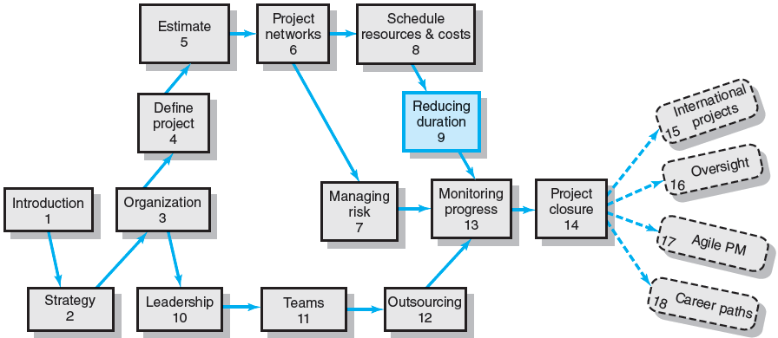
Where We Are Now
Notes:
The need for reducing the project duration occurs for many reasons such as imposed duration dates, time-to-market considerations, incentive contracts, key resource needs, high overhead costs, or simply unforeseen delays. These situations are very common in practice and are known as cost-time trade-off decisions. This chapter presents a logical, formal process for assessing the implications and risks of situations where shortening of activity durations can dramatically affect the sensitivity of an entire network. Time spent up front considering alternatives and developing contingency plans will lead to time savings in the end.

Slide 3
Rationale for Reducing Project Duration
Time Is Money: Cost-Time Tradeoffs
Reducing the time of a critical activity usually incurs additional direct costs.
Cost-time solutions focus on reducing (crashing) activities on the critical path to shorten overall duration of the project.
Reasons for imposed project duration dates:
Time-to-market pressures
Unforeseen delays
Incentive contracts (bonuses for early completion)
Imposed deadlines and contract commitments
Overhead and public goodwill costs
Pressure to move resources to other projects
Notes:
For project managers, time spent on the completion of a project has a money cost. Tradeoffs intended to reduce the time of a critical activity usually incur additional direct costs. Cost-time solutions focus on reducing (crashing) activities on the critical path to shorten overall duration of the project.
There are good reasons for imposing specific project duration dates:
Time-to-market pressures to turn products into sales
Unforeseen delays during the run of the project
Incentive contracts (bonuses for early completion)
Imposed deadlines and contract commitments
Overhead and public goodwill costs
Pressures to move resources to other projects

Slide 4
Options for Accelerating Project Completion
Resources Not Constrained
Adding resources
Outsourcing project work
Scheduling overtime
Establishing a core project team
Do it twice—fast and then correctly
Resources Constrained
Fast-tracking
Critical-chain
Reducing project scope
Compromise quality
Notes:
Managers have several effective methods for crashing specific project activities when resources are NOT constrained:
Adding resources
Outsourcing project work
Scheduling overtime
Establishing a core project team
Do it twice—fast and then correctly
When resources are constrained, managers can use alternative methods to get projects back on track such as:
Fast-tracking by paralleling activities to work concurrently
Critical-chain project management
Reducing project scope by scaling back the project
Compromise quality

Slide 5
Explanation of Project Costs
Project Indirect Costs
Costs that cannot be associated with any particular work package or project activity.
Supervision, administration, consultants, and interest
Costs that vary (increase) with time.
Reducing project time directly reduces indirect costs.
Project Direct Costs
Normal costs that can be assigned directly to a specific work package or project activity.
Labor, materials, equipment, and subcontractors
Crashing activities increases direct costs.
Notes:
Managers encounter two types of project costs:
Indirect costs are variable costs that cannot be associated directly with a particular work package or project activity such as general supervision and administration, project consultant fees, and interest on funds borrowed to finance the project. These time-variable costs can be reduced directly by reducing overall project time.
Project direct costs are normal costs that can be assigned directly to a specific work package or project activity such as labor, materials, equipment, and subcontractors. Crashing activities can increase these direct costs.

Slide 6
Reducing Project Duration to Reduce Project Cost
Identifying direct costs to reduce project time
Gather information about direct and indirect costs of specific project durations.
Search critical activities for lowest direct-cost activities to shorten project duration.
Compute total costs for specific durations and compare to benefits of reducing project time.
Notes:
Project managers can reduce direct costs of a project reducing the duration of the project by taking the following steps:
Gathering information about direct and indirect costs of specific project durations.
Searching critical activities for lowest direct-cost activities to shorten project duration.
Computing total costs for specific durations and making comparisons to the benefits of reducing project time.

Slide 7
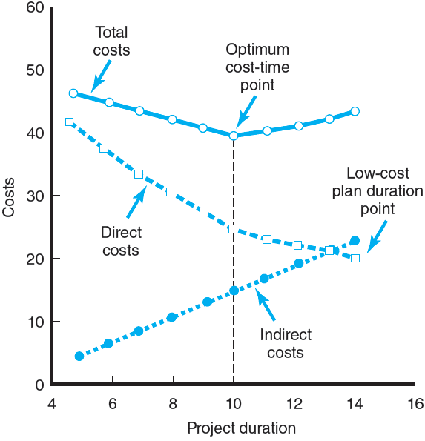
Project Cost–Duration Graph
FIGURE 9.1
Notes:
The general nature of project costs is illustrated as a Project Cost–Duration line graph in Figure 9.1. The uppermost line represents the total for indirect and direct costs for each duration. The rising lowermost line represents indirect costs that continue to grow for the life of the project. Reducing project duration with reduce direct costs. The falling middlemost line represents the decline of direct costs over project’s duration. Direct costs on the graph grow at an increasing rate as the project duration is reduced from its original planned duration. The optimum cost-time for the project occurs at the low point for total costs in the tenth period of the project’s duration.
With the information from a graph such as this for a project, managers can quickly judge any alternative such as meeting a time-to-market deadline.

Slide 8
Constructing a Project Cost–Duration Graph
Determining Activities to Shorten
Shorten the activities with the smallest increase in cost per unit of time.
Assumptions:
The cost relationship is linear.
Normal time assumes low-cost, efficient methods to complete the activity.
Crash time represents a limit—the greatest time reduction possible under realistic conditions.
Slope represents a constant cost per unit of time.
All accelerations must occur within the normal and crash times.
Notes:
Managers use the project-cost duration graph to determine which activities can be time-shorten (crashed) with the smallest increase in resource cost per unit of time. The managers assume the following conditions are present:
The cost increase-time relationship is linear.
Normal time assumes low-cost, efficient methods to complete the activity.
Crash time represents a limit—the greatest time reduction possible under realistic conditions.
The slope represents a constant cost per unit of time.
All accelerations must occur within the normal and crash times.

Slide 9
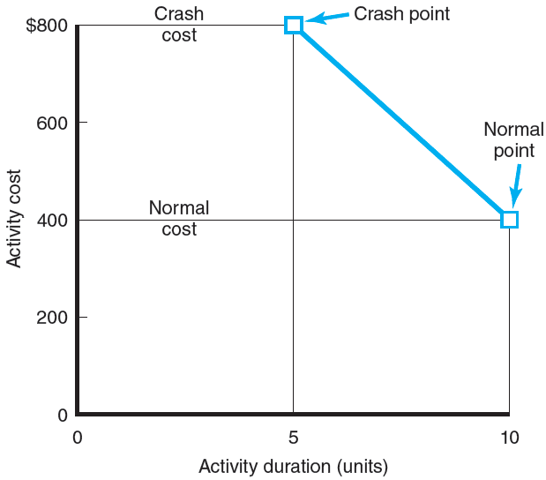
Activity Graph
FIGURE 9.2
Notes:
Figure 9.2 depicts a hypothetical activity cost–duration graph for an activity. The normal time for the activity is 10 time units, and the corresponding cost is $400. The crash time for the activity is five time units and $800. The intersection of the normal time and cost represents the original low-cost, early-start schedule. The crash point represents the maximum time an activity can be compressed. The heavy line connecting the normal and crash points represents the slope, which assumes the cost of reducing the time of the activity is constant per unit of time.
Knowing the slope of activities allows managers to compare which critical activities to shorten. The less steep the cost slope of an activity, the less it costs to shorten one time period; a steeper slope means it will cost more to shorten one time unit. In Figure 9.2 the rise is the y axis (cost) and the run is the x axis (duration). The slope of the cost line is $80 for each time unit the activity is reduced; the limit reduction of the activity time is five time units. Comparison of the slopes of all critical activities allows us to determine which activity(ies) to shorten to minimize total direct cost. Given the preliminary project schedule (or one in progress) with all activities set to their early-start times, the process of searching critical activities as candidates for reduction can begin. The total direct cost for each specific compressed project duration must be found.

Slide 10
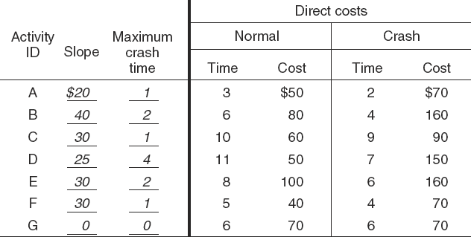
Cost–Duration Trade-off Example
FIGURE 9.3
Notes:
Figure 9.3 presents a boxed data chart of normal and crash times and costs for each activity, the computed slope and time reduction limit, and the total direct cost for a hypothetical project network with a duration of 25 time units. Note the total direct cost for the 25-period duration is $450. This is an anchor point to begin the procedure of shortening the critical path(s) and finding the total direct costs for each specific duration less than 25 time units. The maximum time reduction of an activity is simply the difference between the normal and crash times for an activity.

Slide 11
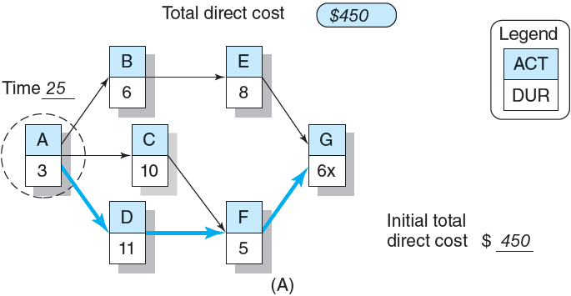
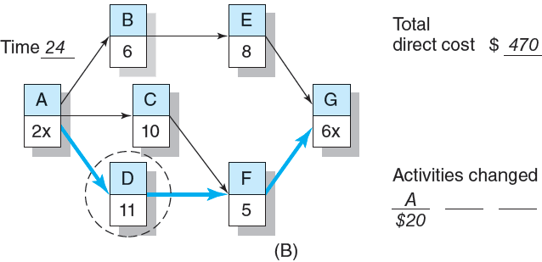
Cost–Duration Trade-off Example (cont’d)
FIGURE 9.3 (cont’d)
Notes:
The network in Figure 9.3A shows the critical path to be activities A, D, F, G. Because it is impossible to shorten activity G (“x” is used to indicate this), activity A is circled because it is the least-cost candidate; that is, its slope ($20) is less than the slopes for activities D and F ($25 and $30). Reducing activity A one time unit cuts the project duration to 24 time units but increases the total direct costs to $470 ($450 + $20 = $470). Figure 9.3B reflects these changes. The duration of activity A has been reduced to two time units; the “x” indicates the activity cannot be reduced any further. Activity D is circled because it costs the least ($25) to shorten the project to 23 time units.

Slide 12
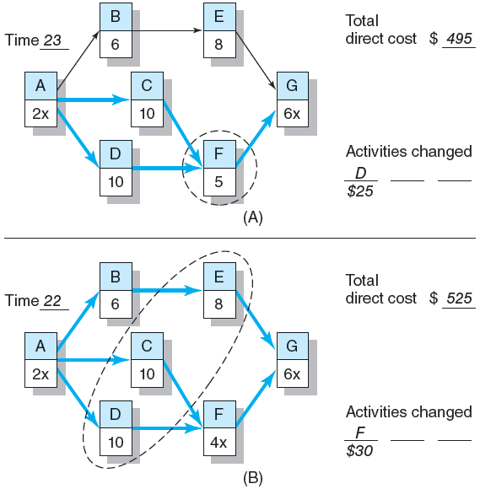
Cost–Duration Trade-off Example (cont’d)
FIGURE 9.4
Notes:
In Figure 9.4a, we compare the cost of activity F in our hypothetical network. The total direct cost for a project duration of 23 time units is now $495. The project network in Figure 9.4A now has two critical paths—A, C, F, G and A, D, F, G. Reducing the project to 22 time units will require that activity F be reduced; thus, it is circled. This change in the network is reflected in Figure 9.4B. The total direct cost for 22 time units is $525. This reduction has created a third critical path—A, B, E, G; in which all activities are critical. The least-cost method for reducing the project duration to 21 time units is the combination of the circled activities C, D, and E which cost $30, $25, $30, respectively, and will increase total direct costs to $610.

Slide 13
Constructing a Project Cost–Duration Graph
Find total direct costs for selected project durations.
Find total indirect costs for selected project durations.
Sum direct and indirect costs for these selected project durations.
Compare additional cost alternatives for benefits.
Notes:
To construct a project cost-duration graph, project managers must do the following:
Find total direct costs for selected project durations.
Find total indirect costs for selected project durations.
Sum direct and indirect costs for these selected project durations.
Compare additional cost alternatives for benefits.

Slide 14
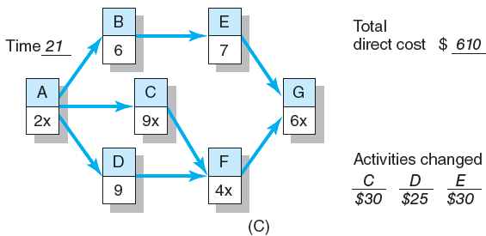
Cost–Duration Trade-off Example (cont’d)
FIGURE 9.4 (cont’d)
Notes:
The results of previous network changes are depicted in Figure 9.4C. Although some activities can still be reduced (those without the “x” next to the activity time), no crashing of any activity or combination of activities will result in a further reduction in the project’s duration.

Slide 15
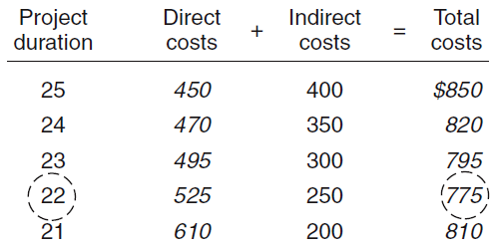
Summary Costs by Duration
FIGURE 9.5
Notes:
With the total direct costs for the array of specific project durations found, the next step is to collect the indirect costs for these same durations. These costs are typically a rate per day and are easily obtained from the accounting department. Figure 9.5 presents the total direct costs, total indirect costs, and total project costs for each project duration time unit in a row and column data grid.

Slide 16
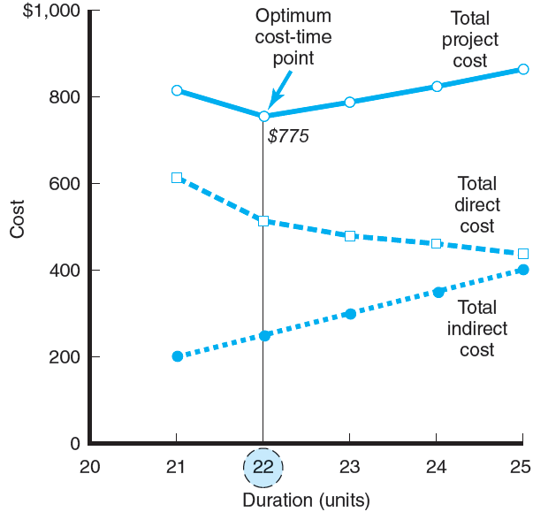
Project Cost–Duration Graph
FIGURE 9.6
Notes:
Total direct costs, total indirect costs, and total project costs for the project’s 20-25 duration time units are plotted on a graph in Figure 9.6. This graph shows that the optimum cost-time duration occurs at 22 time units and a cost of $775. Assuming the project will actually materialize as planned, any movement away from this time duration will increase project costs. The movement from 25 to 22 time units occurs because, in this range, the absolute slopes of the indirect costs are greater than the direct cost slopes.

Slide 17
Practical Considerations
Using the Project Cost–Duration Graph
Crash Times
Linearity Assumption
Choice of Activities to Crash Revisited
Time Reduction Decisions and Sensitivity
Notes:
There are practical matters that project managers must consider in any proposed alternative or change in a network:
Using the project cost–duration graph helps in keeping the importance of indirect costs in the forefront of project decision making.
How to realistically communicate the rough estimations of the accuracy of crash times and costs when compared with normal time and cost.
The necessity for reasonable, quick comparisons using assumptions of linearity in the relationship of compressed activity times and costs
Revisiting the choice of activities to crash based on inherent risks, timing of activities, and overallocation of resources
The risks associated with seeking to reduce project times and the risks of increasing the sensitivity of the project network by such actions.

Slide 18
What if Cost, Not Time Is the Issue?
Commonly Used Options for Cutting Costs
Reducing project scope
Having owner take on more responsibility
Outsourcing project activities or even the entire project
Brainstorming cost savings options
Notes:
When project cost is the paramount issue, project managers can take the following actions to cut project costs:
Reduce project scope to deliver less than originally planned
Have owner take on more responsibility for project activities
Outsourcing project activities or even the entire project
Brainstorming to develop ideas for cost savings options

Slide 19
Key Terms
Crashing
Crash point
Crash time
Direct costs
Fast-tracking
Indirect costs
Outsourcing
Project cost–duration graph
Notes:
Crashing is the shortening an activity or project.
Crash point is the most a project activity time can realistically be compressed with the resources available to the organization.
Crash time is the shortest time an activity can be completed (assuming a reasonable level of resources).
Direct costs are costs that are clearly charged to a specific work package—usually labor, materials, or equipment.
Fast-tracking accelerates project completion typically by rearranging the network schedule and using start-to-start lags.
Indirect costs are costs that cannot be traced to a particular project or work package.
Outsourcing involves contracting for the use of external sources (skills) to assist in implementing a project.
Project cost–duration graph plots project cost against time; it includes direct, indirect, and total cost for a project over a relevant range of time.

Slide 20
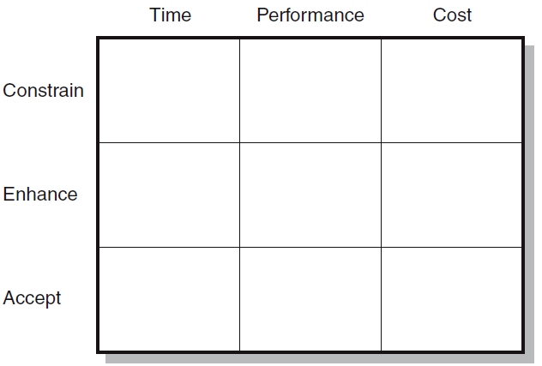
Project Priority Matrix: Whitbread Project
FIGURE C9.1
Notes:
Figure C9.1 presents a priority matrix for use in project decision making in the Whitbread Project.

